Slide 1
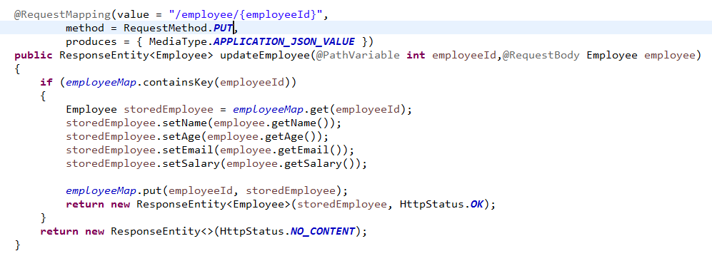
Handle HTTP PUT Request

